Slide 1
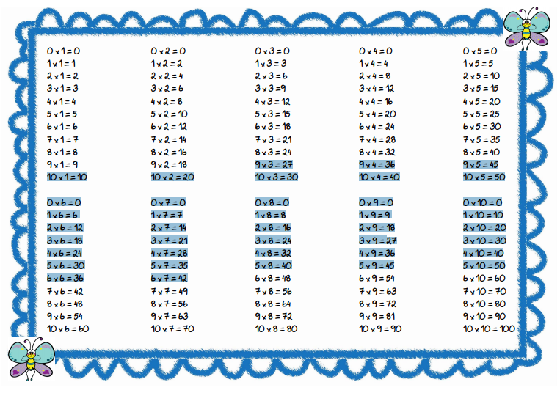
0 : 1 = 0
1 : 1 = 1
2 : 1 = 2
3 : 1 = 3
4 : 1 = 4
5 : 1 = 5
6 : 1 = 6
7 : 1 = 7
8 : 1 = 8
9 : 1 = 9
10 : 1 =10
0 : 2 = 0
2 : 2 = 1
4 : 2 = 2
6 : 2 = 3
8 : 2 = 4
10 : 2 = 5
12 : 2 = 6
14 : 2 = 7
16 : 2 = 8
18 : 2 = 9
20 : 2 =10
0 : 3 = 0
3 : 3 = 1
6 : 3 = 2
9 : 3 = 3
12 : 3 = 4
15 : 3 = 5
18 : 3 = 6
21 : 3 = 7
24 : 3 = 8
27 : 3 = 9
30 : 3 =10
0 : 4 = 0
4 : 4 = 1
8 : 4 = 2
12 : 4 = 3
16 : 4 = 4
20 : 4 = 5
24 : 4 = 6
28 : 4 = 7
32 : 4 = 8
36 : 4 = 9
40 : 4 =10
0 : 5 = 0
5 : 5 = 1
10 : 5 = 2
15 : 5 = 3
20 : 5 = 4
25 : 5 = 5
30 : 5 = 6
35 : 5 = 7
40 : 5 = 8
45 : 5 = 9
50 : 5 =10
0 : 6 = 0
6 : 6 = 1
12 : 6 = 2
18 : 6 = 3
24 : 6 = 4
30 : 6 = 5
36 : 6 = 6
42 : 6 = 7
48 : 6 = 8
54 : 6 = 9
60 : 6 =10
0 : 7 = 0
7 : 7 = 1
14 : 7 = 2
21 : 7 = 3
28 : 7 = 4
35 : 7 = 5
42 : 7 = 6
49 : 7 = 7
56 : 7 = 8
63 : 7 = 9
70 : 7 =10
0 : 8 = 0
8 : 8 = 1
16 : 8 = 2
24 : 8 = 3
32 : 8 = 4
40 : 8 = 5
48 : 8 = 6
56 : 8 = 7
64 : 8 = 8
72 : 8 = 9
80 : 8 =10
0 : 9 = 0
9 : 9 = 1
18 : 9 = 2
27 : 9 = 3
36 : 9 = 4
45 : 9 = 5
54 : 9 = 6
63 : 9 = 7
72 : 9 = 8
81 : 9 = 9
90 : 9 =10
0 : 10 = 0
10 : 10 = 1
20 : 10 = 2
30 : 10 = 3
40 : 10 = 4
50 : 10 = 5
60 : 10 = 6
70 : 10 = 7
80 : 10 = 8
90 : 10 = 9
100 : 10 =10

